Slide 1
ECG SIGNAL CLASSIFICATION
Amitoj Singh - 3122 21 5002 010
Harsh Bansal - 3122 21 5002 036

Slide 2
PROBLEM STATEMENT
Developing a system capable of accurately classifying electrocardiogram (ECG) signals into three categories: arrhythmia, congestive heart failure (CHF), and normal sinus rhythm (NSR). Upon classification, appropriate actions will be triggered based on the detected condition. For arrhythmia, additional monitoring will be recommended, while congestive heart failure will prompt a consultation with a healthcare professional. In the case of normal sinus rhythm, no immediate action will be required. We aim to enhance healthcare monitoring by automating ECG signal analysis and providing timely interventions when necessary.

Slide 3
OBJECTIVES
Develop a robust deep learning model to accurately classify ECG signals into arrhythmia, congestive heart failure (CHF), and normal sinus rhythm (NSR) categories.
Train the model on a diverse and extensive dataset of ECG signals to ensure robustness and generalization to various patient demographics and conditions.
Implement an intuitive and user-friendly interface for real-time ECG signal classification, enabling seamless integration into clinical environments.
Validate the performance of the developed system through rigorous testing and evaluation against established benchmarks and clinical standards.
Facilitate timely and appropriate interventions by automatically triggering alerts or notifications based on the detected ECG signal classification, enhancing patient care and outcomes.

Slide 4
PROPOSED SOLUTION
We have implemented the Pan-Tompkins algorithm to detect R-peaks in ECG signals accurately, enabling precise identification of QRS complexes.
Applied finite impulse response (FIR) bandpass filtering to enhance the quality of ECG signals by effectively removing noise.
We have utilized discrete wavelet transform (DWT) with Daubechies wavelet (db4) to decompose ECG signals into their frequency components.
Converted ECG signals into continuous wavelet transform (CWT) spectrograms, capturing both time and frequency features for improved analysis.
Transformed CWT spectrograms into RGB image format, facilitating classification using pre-trained deep-learning models like AlexNet.
We have employed transfer learning techniques to classify ECG signal images into arrhythmia, congestive heart failure (CHF), and normal sinus rhythm (NSR) classes.
To provide real-time feedback on the predicted class of ECG signal images, enabling prompt medical intervention or further evaluation as necessary.

Slide 5
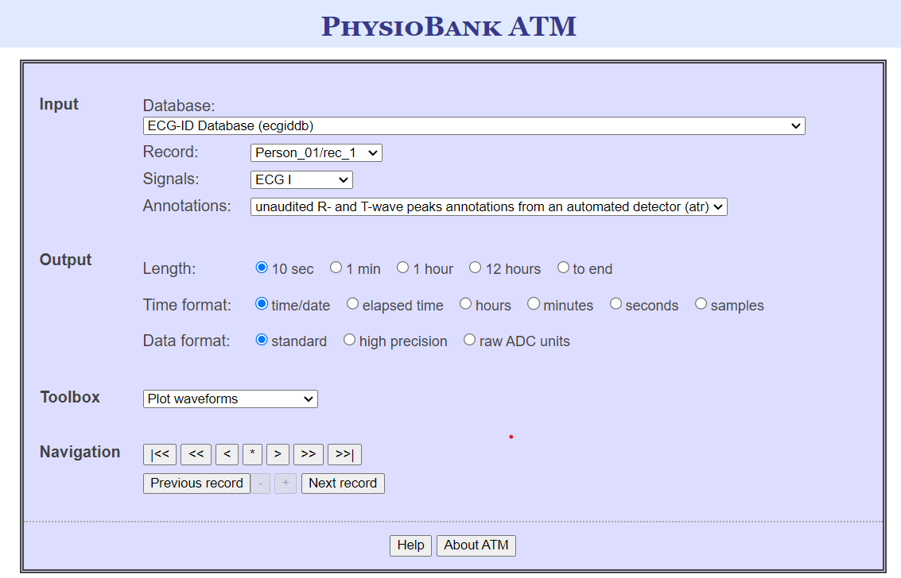
ABOUT THE DATASET
We obtained our dataset named the “ECG-ID Database (ecgiddb)” from PhysioNet.org.
This resource focuses on various heart diseases identification using ECG signals.
Use the link
(https://archive.physionet.org/cgi-bin/atm/ATM) to explore ECG-based identification methods using this dataset.

Slide 6
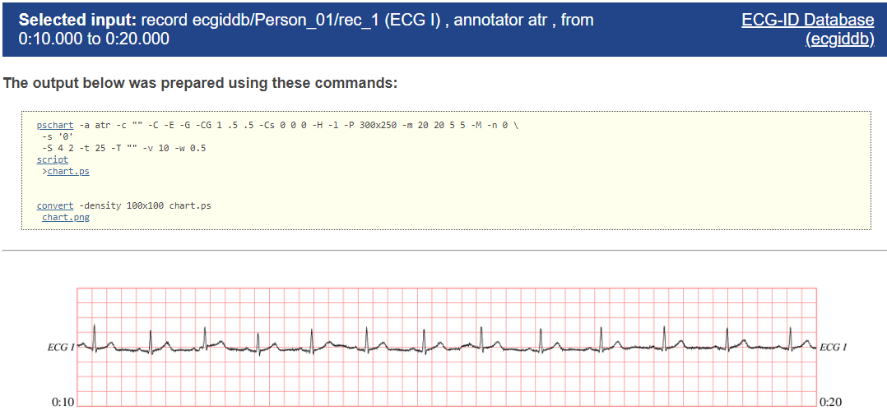
ABOUT THE DATASET
ECG Signals Database
We use ECG signals of three categories:
Cardiac Arrhythmia (ARR)
Congestive Heart Failure (CHF) and
Normal Sinus Rhythms (NSR).
These signals are obtained from 162 ECG recordings from three PhysioNet databases:
MIT-BIH Arrhythmia Database (96 Recordings) [ARR Signals]
MIT-BIH Normal Sinus Rhythm Database (30 Recordings) [NSR Signals]
BIDMC Congestive Heart Failure Database (36 Recordings) [CHF Signals].

Slide 7
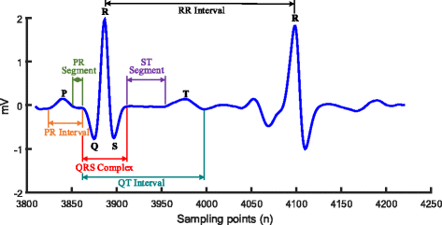
R-Peak Detection Using Pan-Tompkins Algorithm
R-peak detection is a crucial step in ECG signal processing, as it marks the peak amplitude of the QRS complex.
The Pan-Tompkins algorithm is widely used for R-peak detection due to its effectiveness in real-time processing and noise robustness.
R-peak detection involves identifying sharp increases in the ECG signal amplitude that correspond to the R-wave of the QRS complex.

Slide 8
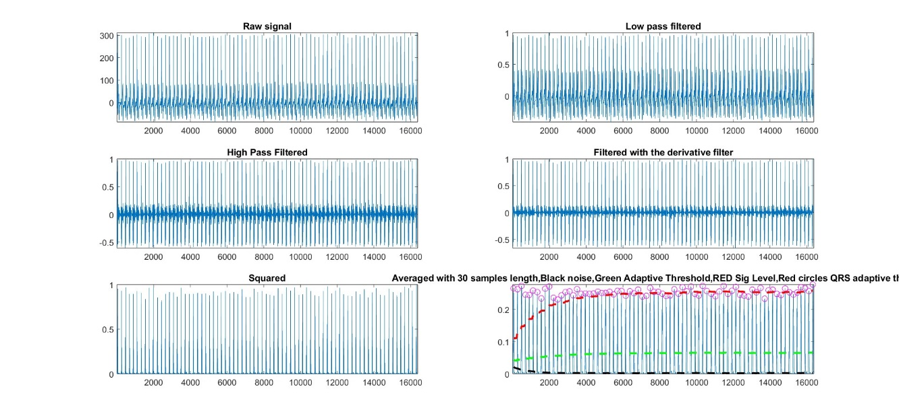
Feature Extraction: The Pan-Tompkins algorithm begins by extracting relevant features from the ECG signal, focusing on characteristics associated with the QRS complex, such as amplitude and duration.
Q-Wave and S-Wave Detection: It identifies candidate QRS complexes by detecting points where the signal exceeds a specified threshold, marking the onset of the Q-wave and the end of the S-wave.
Peak Confirmation: Once potential R-peaks are identified, the algorithm verifies them by analyzing the signal within a defined window, confirming the presence of a distinct peak characteristic of the R-wave. This step helps minimize false positives and ensures accurate detection of R-peaks.

Slide 9
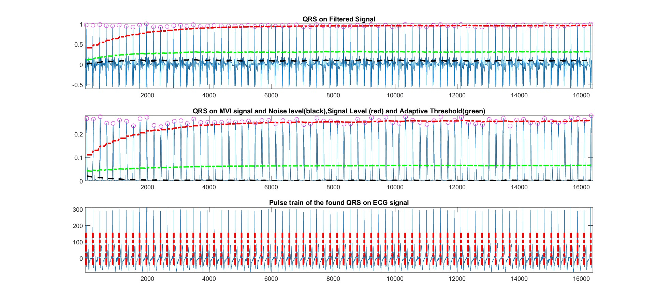
R-peak is detected and marked with a pink circle.

Slide 10
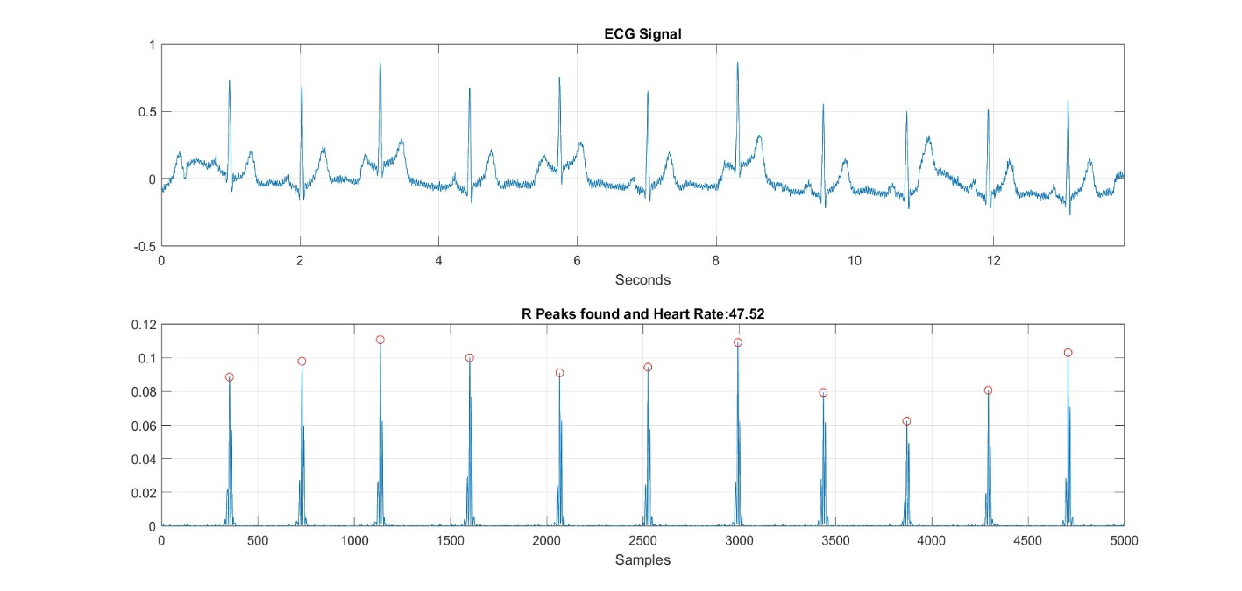
Symlet Wavelet (Sym4)
Symlet wavelets, like Sym4, are a type of orthogonal wavelet used in signal processing and data compression.
Sym4 is characterized by a high number of vanishing moments, which allows it to efficiently capture both smooth and oscillatory components of signals.
It strikes a balance between time and frequency localization, making it suitable for analyzing non-stationary signals like ECG.

Slide 11
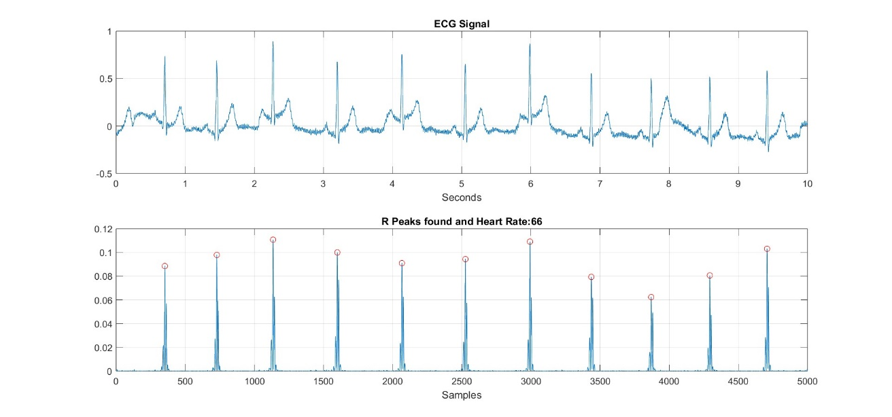
Discrete Wavelet Transform (DWT)
DWT is a signal processing technique used to decompose a signal into different frequency components.
It employs wavelet functions to capture signal details at various scales, providing a multi-resolution analysis of the input signal.
In ECG analysis, DWT can help extract relevant features representing different aspects of cardiac activity, such as QRS complexes, P-waves, and T-waves.

Slide 12
ECG Signal Classification using Deep Neural Networks(CNN)
PROCEDURE
1. ECG Signals to Image conversion using CWT.
All the 1D ECG signals will be converted into images using Continuous Wavelet Transform (CWT)so that they can be fed as input to CNN for classification.
After conversion of all ECG signals, we have total 900 scalogram images saved in three folders corresponding to each category ARR, CHF and NSR.

Slide 13
Parameters for CWT
For Continuous Wavelet Transform (CWT), we take the following parameters.
Wavelet used is 'Analytic Morlet (amor)’.
This wavelet has equal variance in time and frequency.
Analytic wavelets are wavelets with one-sided spectra and are complex-valued in the time domain.
These wavelets are a good choice for obtaining a time-frequency analysis using the CWT.

Slide 14
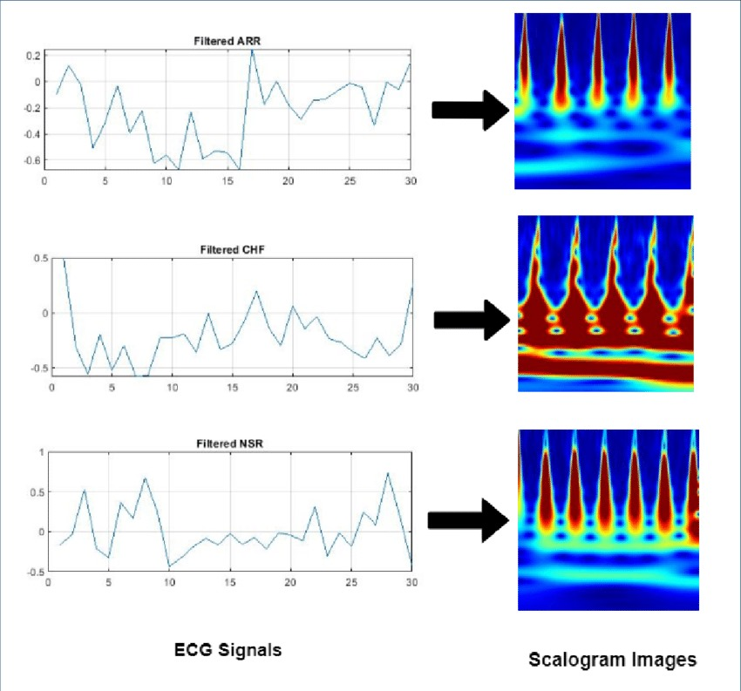
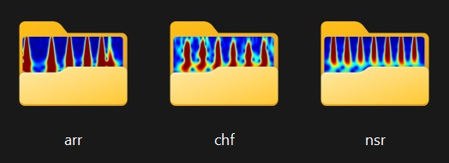
Different Signals to Scalogram images

Slide 15
2. Transfer Learning via AlexNet For ECG signal classification.
We use a pre-trained deep CNN: AlexNet.
AlexNet has been trained on over a million images and can classify images into 1000 object categories.
Fine-tuning a pre-trained CNN to perform classification on a new collection of images is called Transfer learning.
Transfer learning is quick and easy rather than training a CNN from scratch which requires millions of input images, lots of training time, and high-speed efficient hardware.

Slide 16
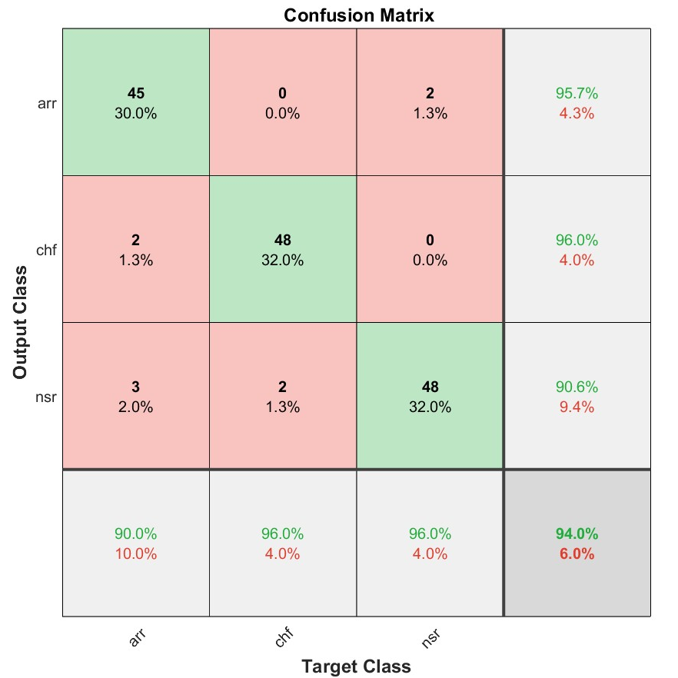
The table demonstrates the efficacy of subject-independent model in ECG classification across 3 different classes.
MODEL | ACCUR ACY (in %) | PRECISION (in %) |  |  |  | RECALL (in %) |  |  |  | SPECIFICITY (in %) |  |  |  | F1 SCORE (in %)
Disease |  | arr | chf | nsr |  | arr | chf | nsr |  | arr | chf | nsr |  | arr | chf | nsr
Score | 94 | 93.75 | 97.67 | 90.57 |  | 95.74 | 98.01 | 96 |  | 94.56 | 95.30 | 92.13 |  | 94.73 | 98.81 | 93.26
Confusion matrix depicting the evaluation metrics - accuracy, precision, recall, specificity and F1 Score

Slide 17
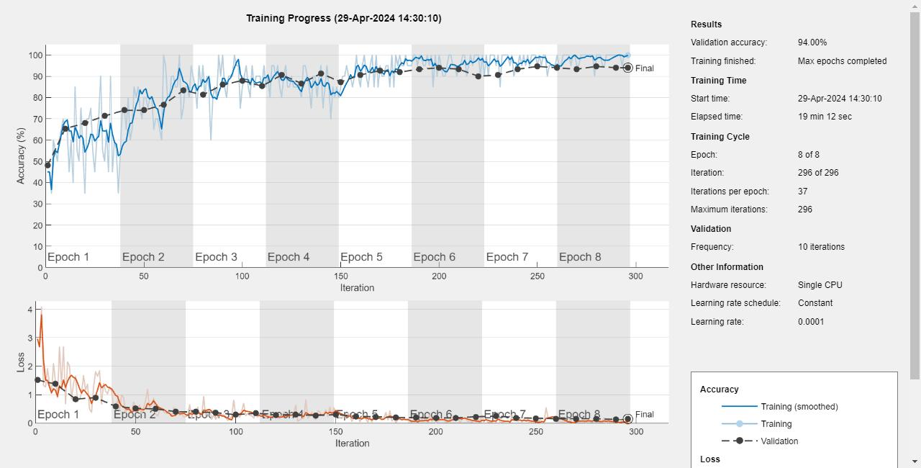
Achieved an accuracy of 94%.

Slide 18
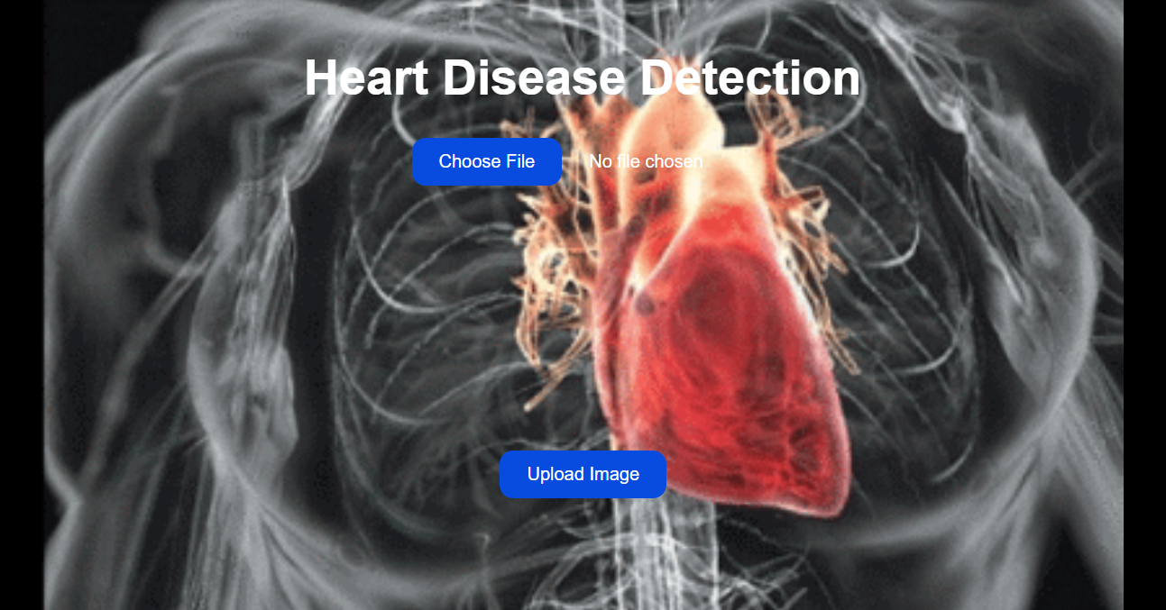
Output

Slide 19
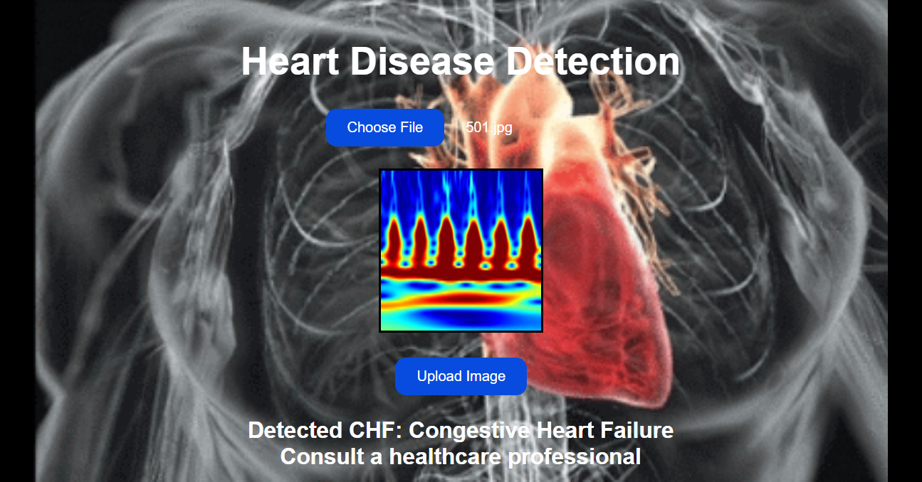

Slide 20
CONCLUSION
ECG signals are important to diagnose various heart diseases. Besides manual inspection, computer-aided inspection can also play an important role in almost accurate diagnosis.
Computer-aided diagnosis saves time, money, and the requirement of expertise availability.
This machine interpretation can be accommodated in portable hardware devices also that can help people in early diagnosis and medication.
Wavelets have established their significance in ECG feature extraction and helped deep neural networks to predict accurate results up to 99% accuracy.
Symlet4 wavelet has proved to be a better choice for ECG signal analysis in DWT, and Analytic Morlet is found better in CWT of ECG signals.

